Slide 1
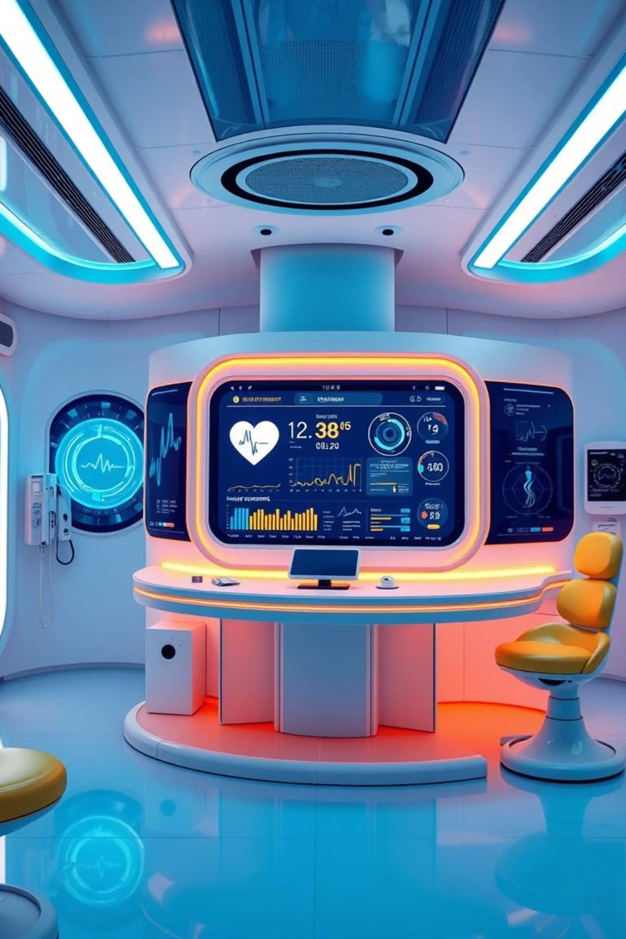
AI Health Diagnosis Chatbot
Revolutionizing Rural Healthcare with AI
Bhabani Naik (23CSE641), Abhishek Kumar (23CSE644), Shubham Shekhar Panda (23CSE515), Krishna Maigaraj (23CSEAIML160)

Slide 2
The Problem Statement:
Limited Access to Care
Doctor Shortages
Communication Barriers
Rural populations often face significant barriers in accessing timely and adequate healthcare services due to geographical isolation.
A critical scarcity of doctors and specialists in rural areas leads to long waiting times and delayed diagnoses.
Language and literacy challenges further complicate healthcare interactions, hindering effective communication between patients and providers.

Slide 3
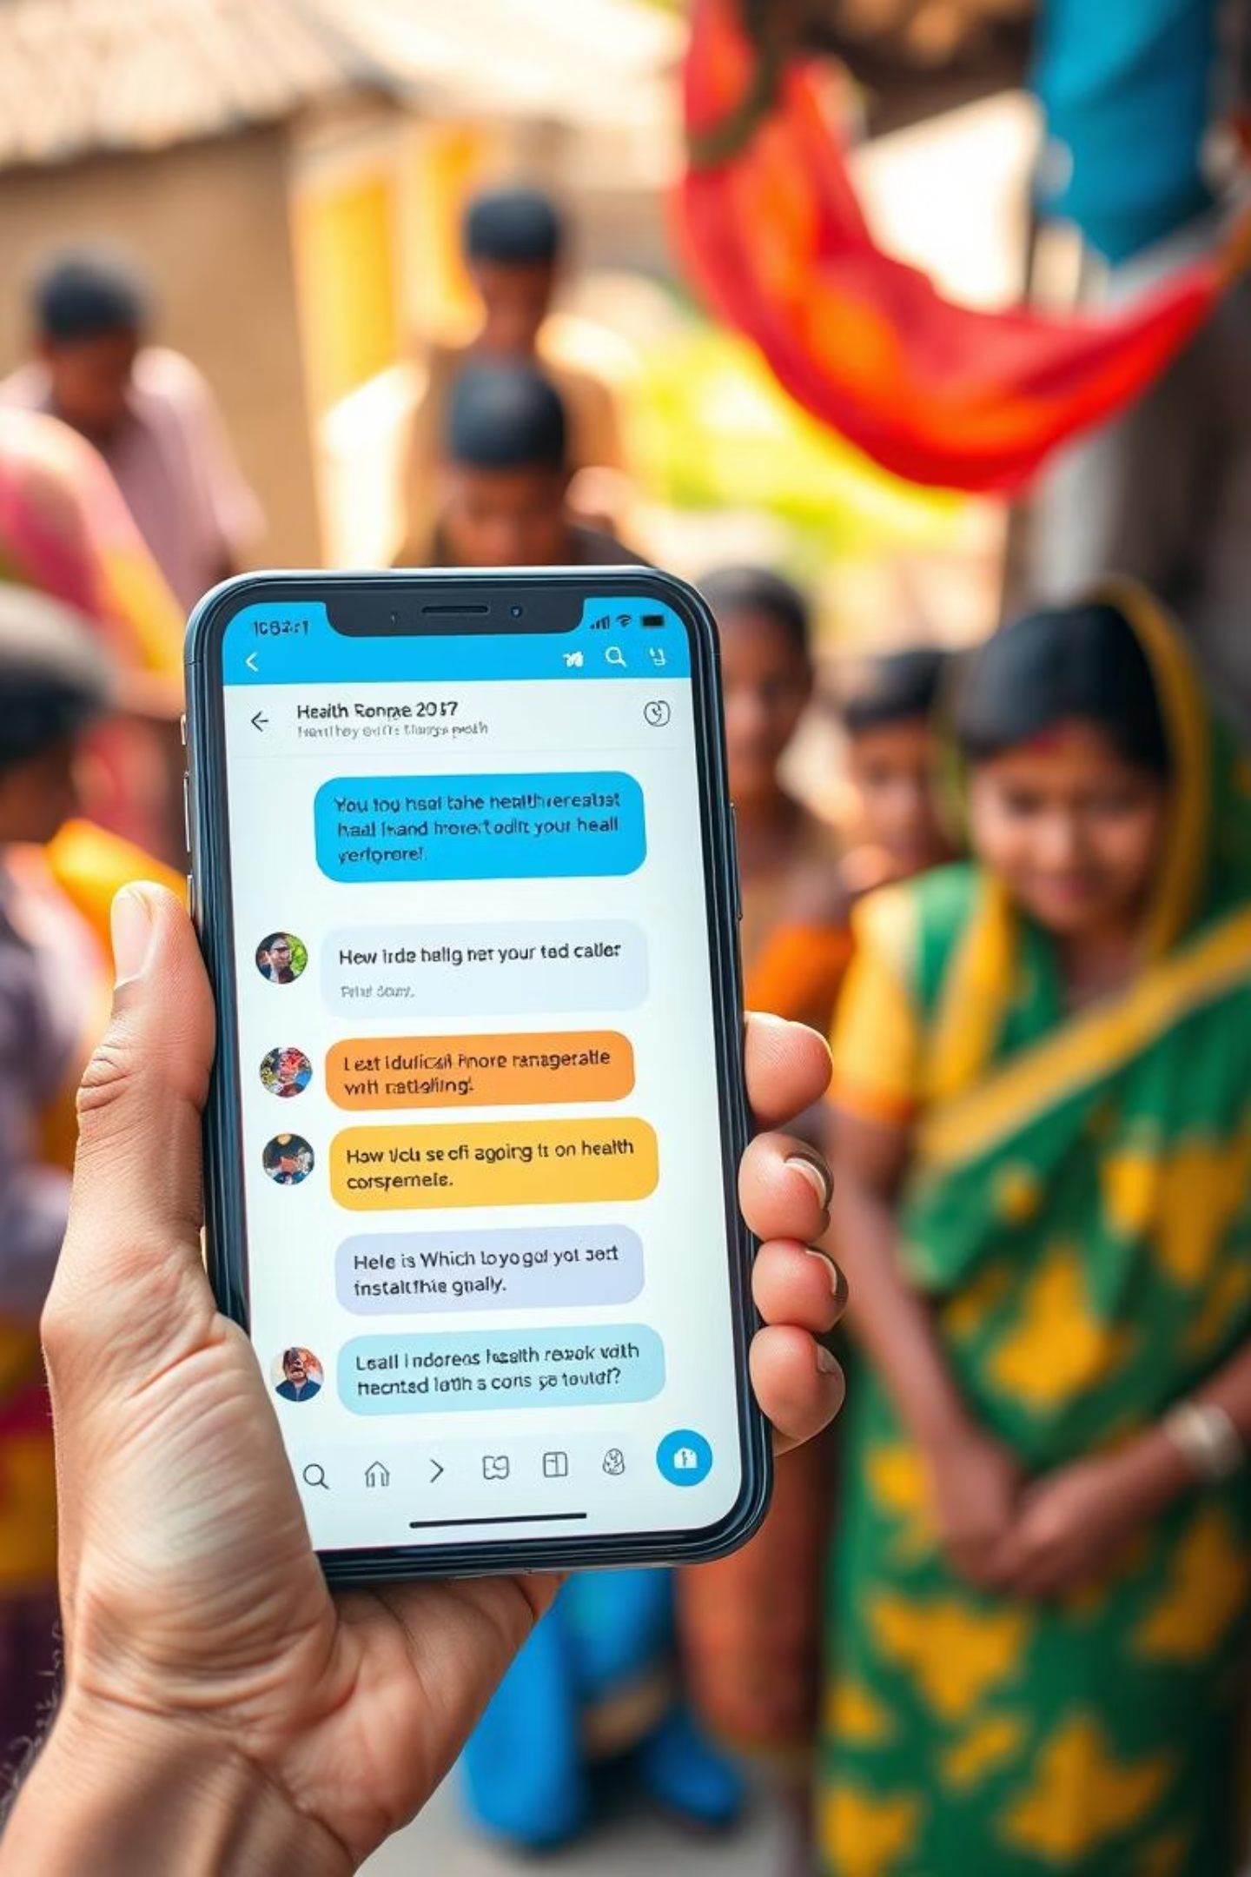
Our Solution: Project Goals
Our primary objective is to develop an AI-powered chatbot designed to bridge these gaps by offering accessible basic health diagnoses.
Basic Diagnosis
1
AI-powered symptom-based diagnosis.
Multilingual Support
2
Comprehensive text and voice input/output.
Offline Capability
3
Ensuring functionality even without internet access.

Slide 4





Key Features
Symptom-Based Diagnosis
Multilingual Interface
Voice Input & Output
Utilises advanced ML models for accurate initial assessments.
Supports diverse languages for broader accessibility and inclusivity.
Enables natural interaction, catering to users with literacy barriers.
Doctor Referral System
Mobile-Friendly Design
Connects users to the nearest available healthcare professionals.
Optimised for seamless use on various mobile devices.

Slide 5

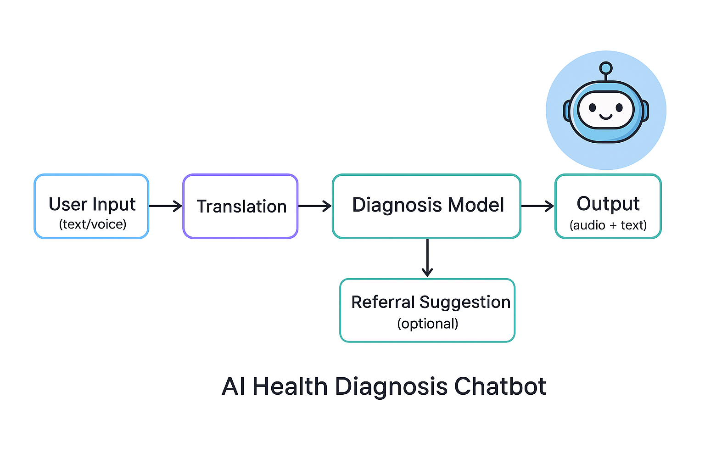

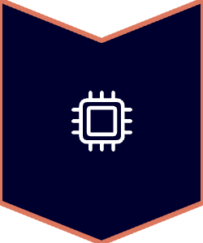


Architecture Overview
The chatbot’s architecture is designed for intuitive interaction and efficient processing.
User Input
Text or Voice
Translation
Multilingual Processing
Diagnosis Model
AI-Powered Analysis
Output
Audio & Text
Referral Suggestion
Optional Nearest Doctor

Slide 6

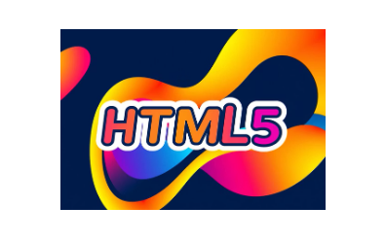
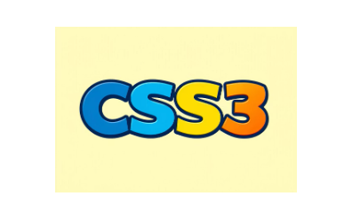
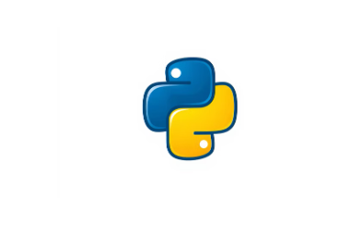
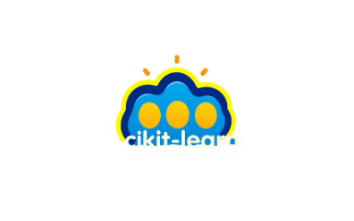
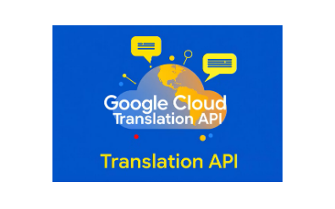
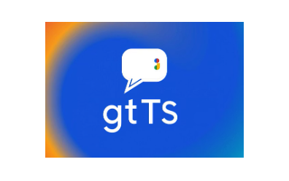

Technologies Used
Backend: Flask powers our robust backend, handling requests and managing data flow.
Multilingual Support: Deep Translator facilitates seamless language conversion.
Frontend: HTML and CSS create a user-friendly and responsive interface.
Voice Integration: gTTS (Google Text-to-Speech) and SpeechRecognition enable voice input and output.
AI Model: Python with Scikit-learn forms the core of our diagnosis engine.

Slide 7
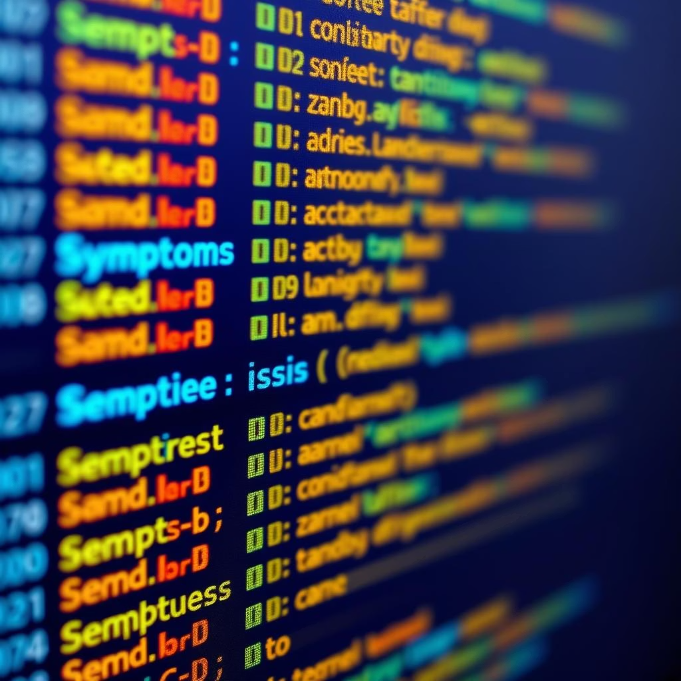



Dataset and Model Insights
Custom Symptom-Disease Dataset
Developed from various medical sources and validated for relevance.
Decision Tree Model
Chosen for its interpretability and effectiveness in classification tasks.
Performance Metrics
Achieved a 92% accuracy rate in preliminary tests, ensuring reliable diagnoses.

Slide 8



Future Enhancements
.
Medical Image Analysis
Implementing features for visual diagnosis, starting with common skin conditions.
Real-Time Doctor Chat
Integrating direct communication with medical professionals for complex cases.
Full-Fledged Mobile Application
Developing a dedicated app with enhanced functionalities and offline capabilities.
Thank You
For more information or questions, please contact us.

